Slide 1
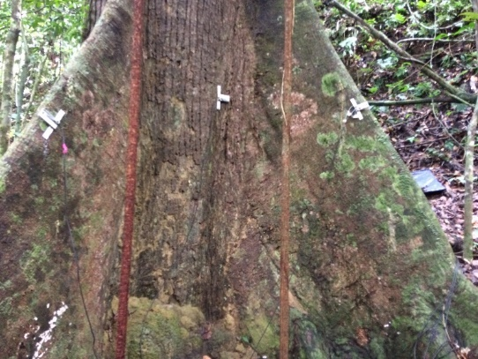
Strain gauge data
tobydjackson@gmail.com
github.com/TobyDJackson/
DOI & Link for Wytham
DOI & Link for Danum
Notes:
Nice graph and how did we get here. Put TLS derived images throughout the presentation + references where appropriate.

Slide 2
Overview
Collect data
Resonant frequency analysis
Availability
Calibrate data
Size of calliper
Coefficient
Angle
Remove offsets
4. Max strain
Cylinder assumption
Streamwise / cross-stream
5. Max strain per hour /minute
Extrapolation up to breaking strain
n==2
Power law fits
Log-log fits

Slide 3
Sensitivity Analysis
Window length |  | CWS estimates (quadratic, m/s)
 |  | Tree 18 | Tree 19 | Tree 20 | Tree 21
1000 | 4.16 mins | 25.0 | 35.4 | 33.8 | 33.0
5000 | 20.8 mins | 25.3 | 38.6 | 34.2 | 33.0
15,000 | 1.02 hours | 25.5 | 38.7 | 33.3 | 32.5
45,000 | 3.08 hours | 24.4 | 37.6 | 33.2 | 32.1
Conclusion:
Data processing choices affect CWS estimates, their relative importance is:
Extrapolation fit type
Choice of resolution
Maximum selection method
Window length
Fitting type | CWS estimates (1000 point window, m/s)
 | Tree 18 | Tree 19 | Tree 20 | Tree 21
n==2 | 25.0 | 35.4 | 33.8 | 33.0
Log-log semi-major axis | 22.2 | 31.2 | 27.5 | 26.0

Slide 4
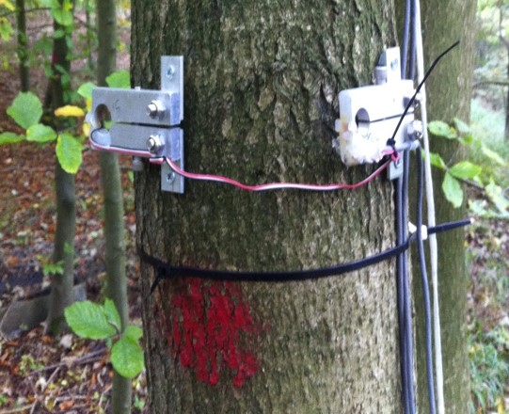
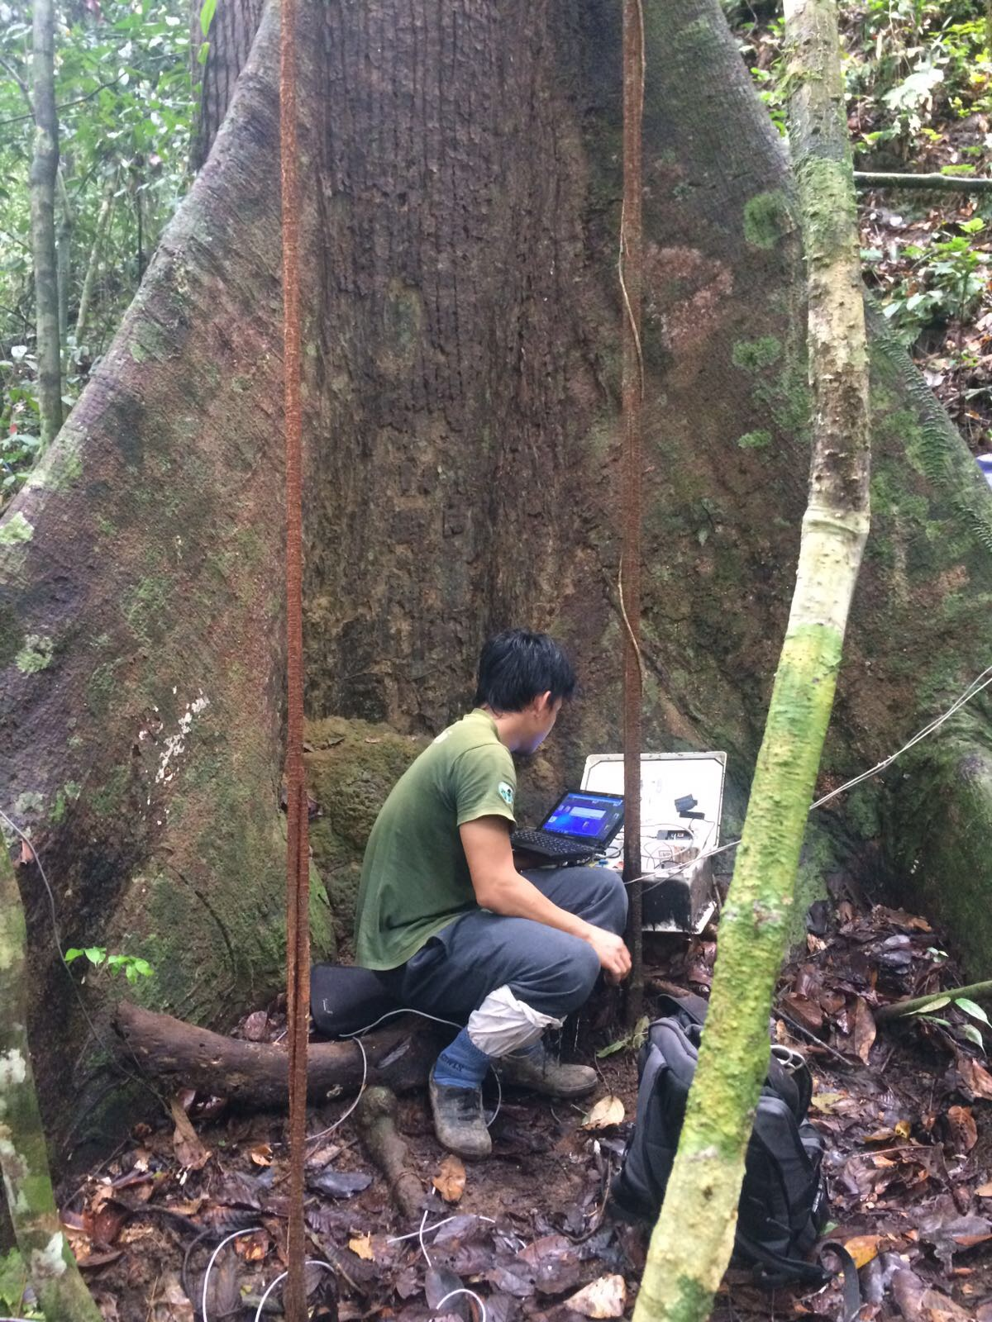
1. Collect data
Notes:
Moore ‘inexpensive instrument

Slide 5
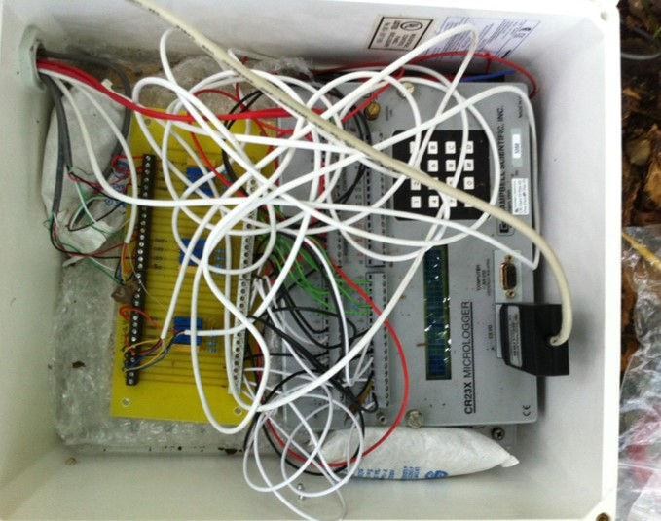
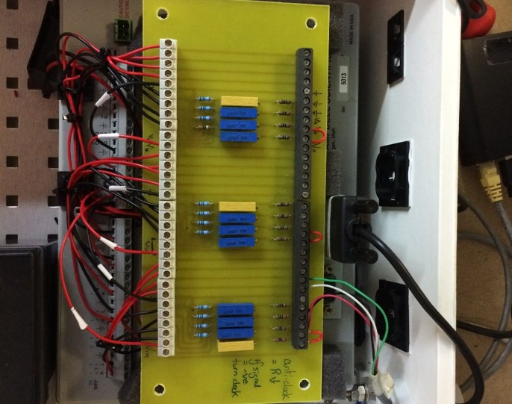
1. Collect data

Slide 6
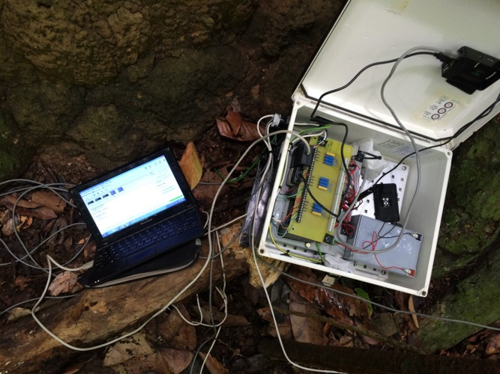
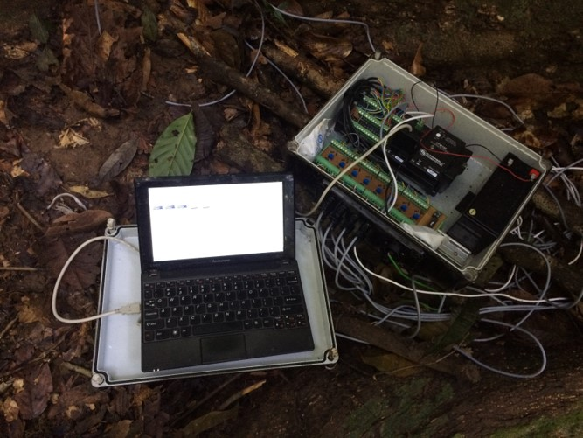
1. Collect data

Slide 7
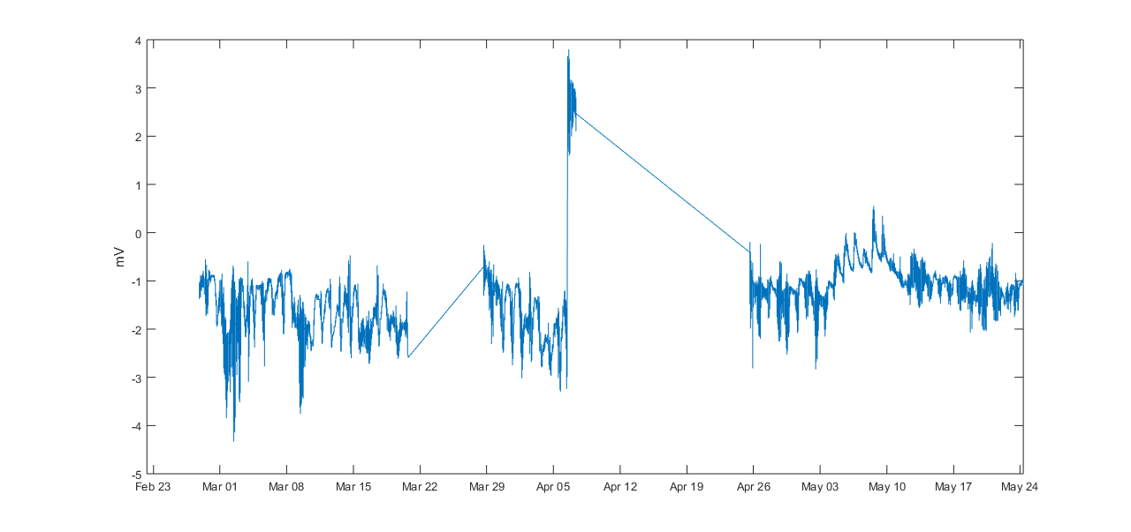
1. Collect data

Slide 8
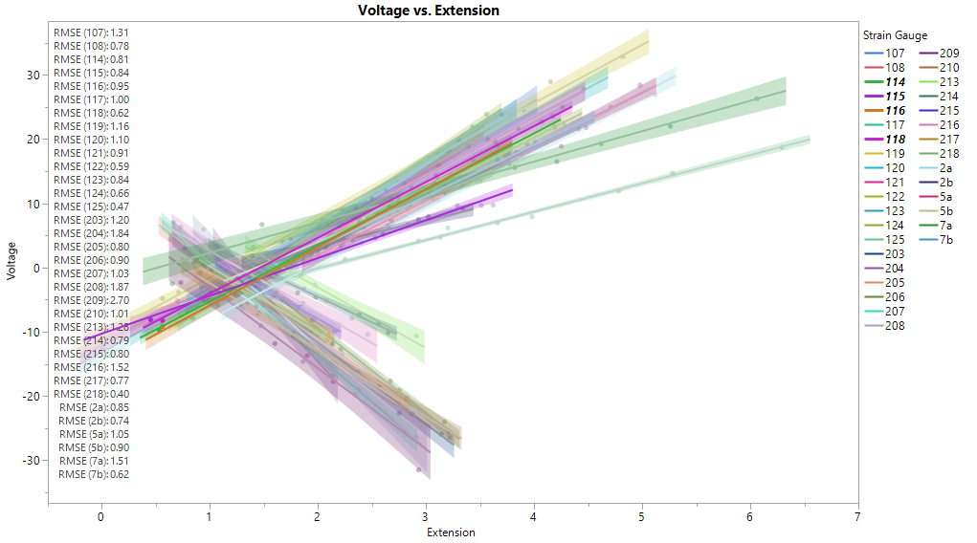
2. Calibrate data

Slide 9
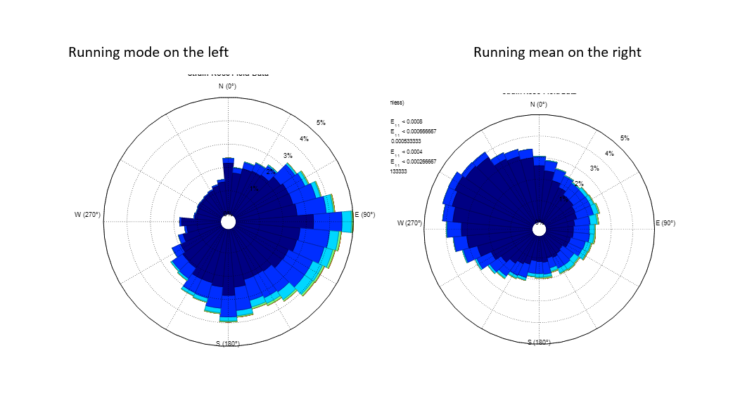
3. Remove offsets
Notes:
I need to re-do this analysis

Slide 10
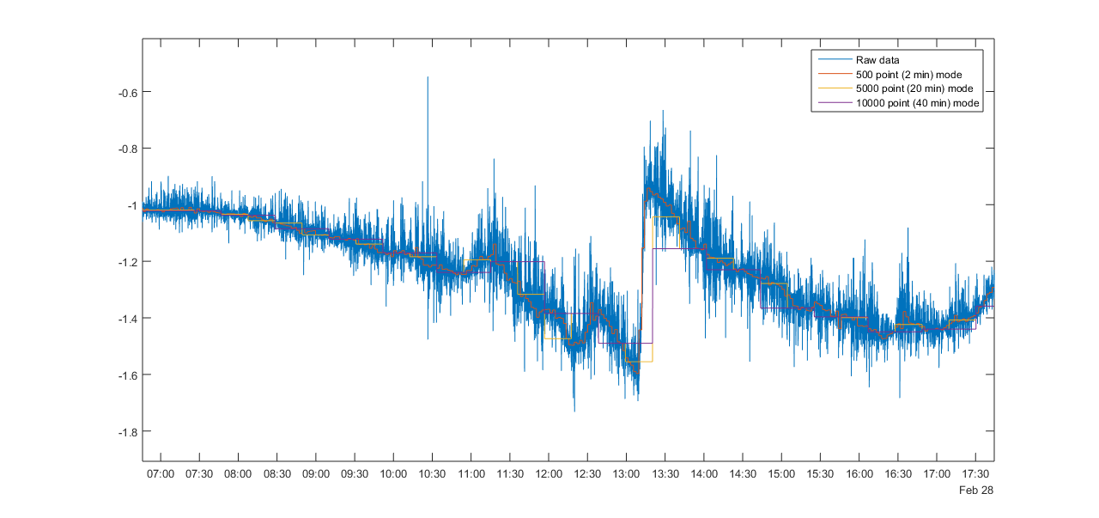
3. Remove offsets

Slide 11
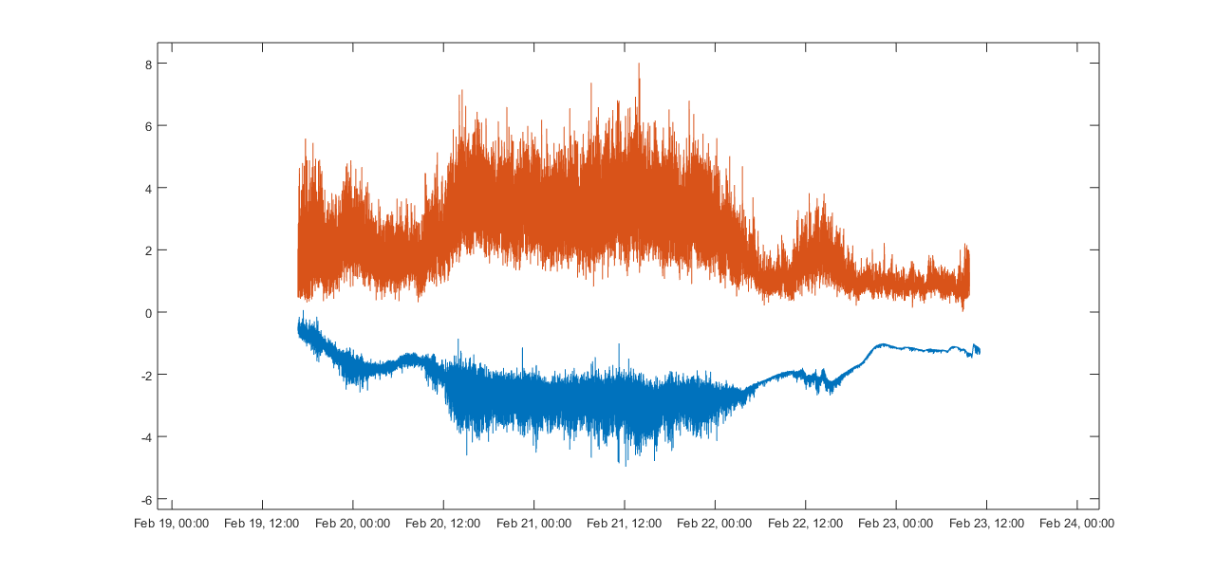
3. Remove offsets
Notes:
Wytham vs Borneo Context – storms.

Slide 12
4. Max strain (4Hz)
Notes:
Just Pythagoras! You get pretty much the same result if the last two steps are performed in the other order. This step assumes the tree is a cylinder! If you want to extract resonant frequencies – do it before this point!

Slide 13
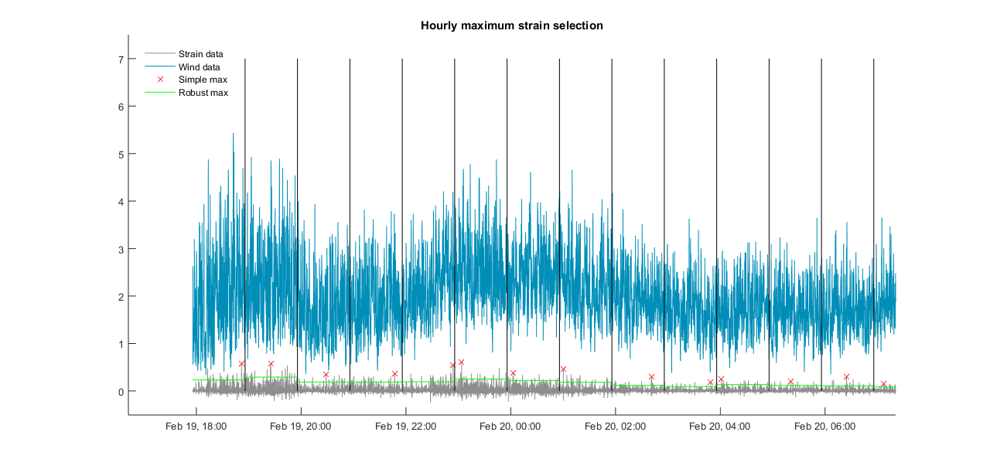
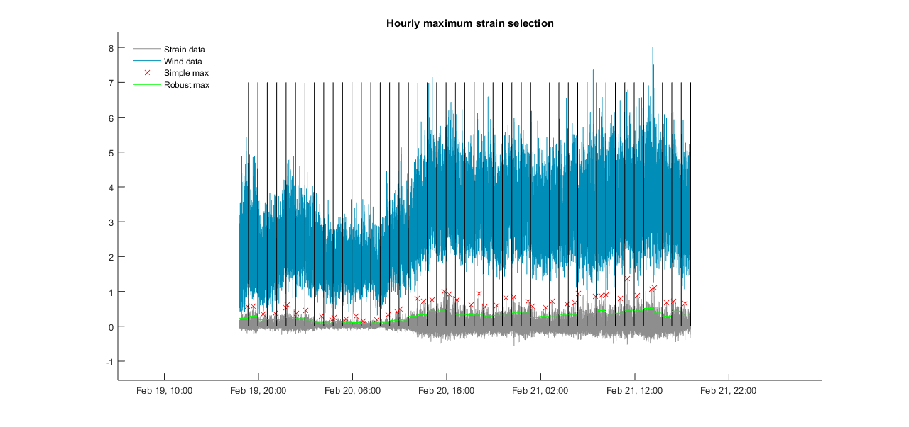
5. Max hourly / minute

Slide 14
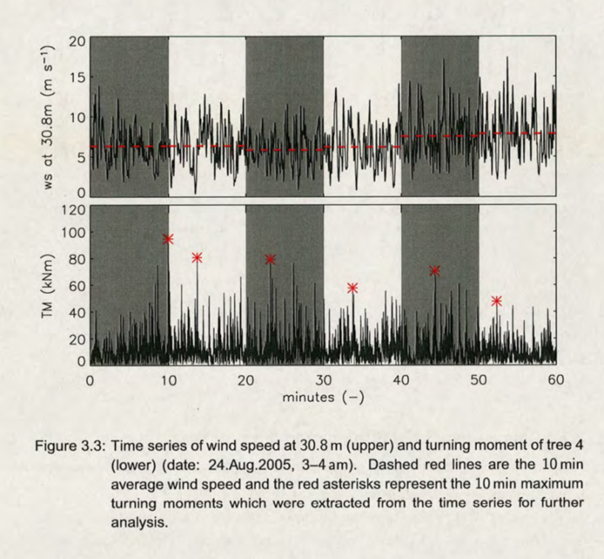
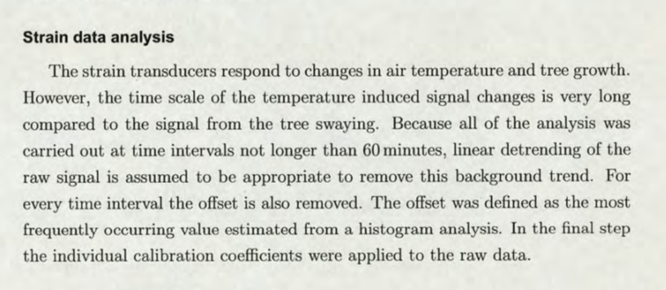
5. Max hourly / minute

Slide 15
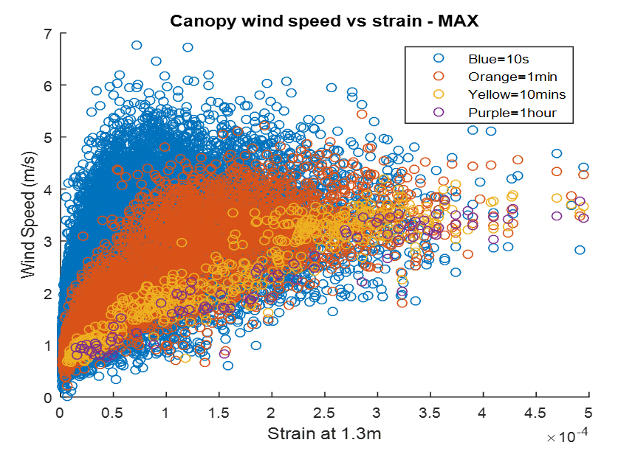
5. Max hourly / minute

Slide 16
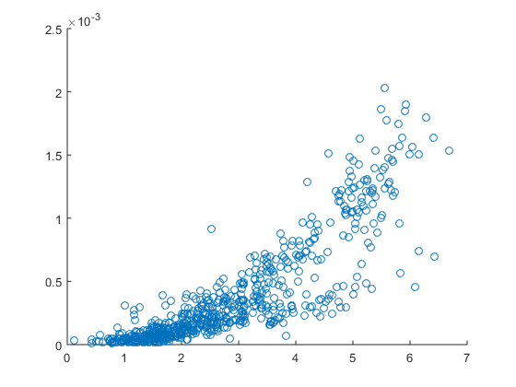
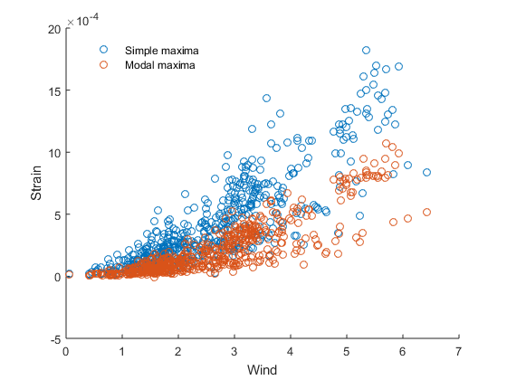
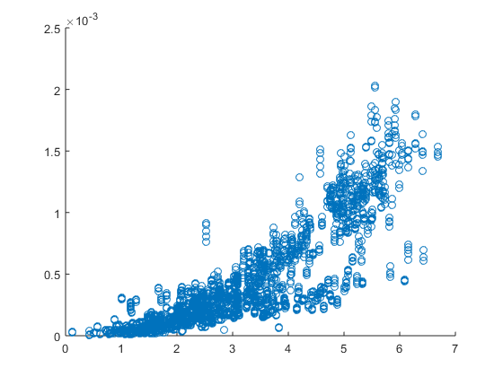
5. Max hourly / minute
Notes:
Link to the function.

Slide 17

6. Extrapolating up to breaking strain
$$ε=av_{ws}^{n}+b$$
Notes:
Mean vs max wind speed?

Slide 18
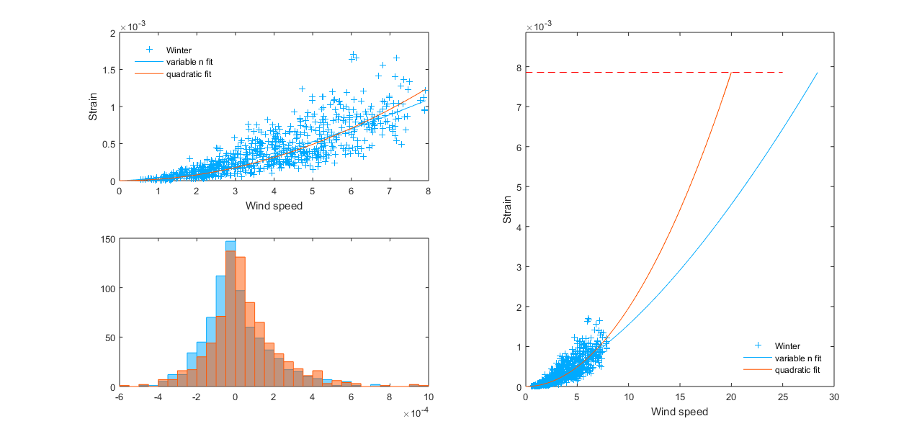
6. Extrapolating up to breaking strain
Notes:
Power law fitting

Slide 19
6. Extrapolating up to breaking strain

Slide 20
6. Extrapolating up to breaking strain

Slide 21
Sensitivity Analysis
Window length |  | CWS estimates (quadratic, m/s)
 |  | Tree 18 | Tree 19 | Tree 20 | Tree 21
1000 | 4.16 mins | 25.0 | 35.4 | 33.8 | 33.0
5000 | 20.8 mins | 25.3 | 38.6 | 34.2 | 33.0
15,000 | 1.02 hours | 25.5 | 38.7 | 33.3 | 32.5
45,000 | 3.08 hours | 24.4 | 37.6 | 33.2 | 32.1
Conclusion:
Data processing choices affect CWS estimates, their relative importance is:
Extrapolation fit type
Choice of resolution
Maximum selection method
Window length
Fitting type | CWS estimates (1000 point window, m/s)
 | Tree 18 | Tree 19 | Tree 20 | Tree 21
n==2 | 25.0 | 35.4 | 33.8 | 33.0
Log-log semi-major axis | 22.2 | 31.2 | 27.5 | 26.0

Slide 22
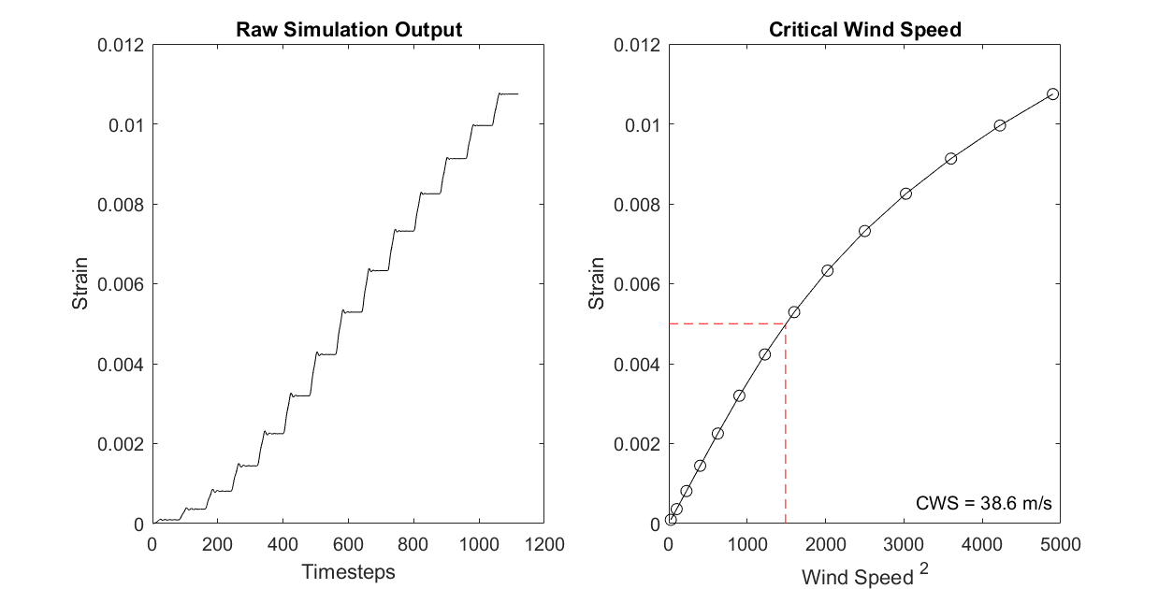
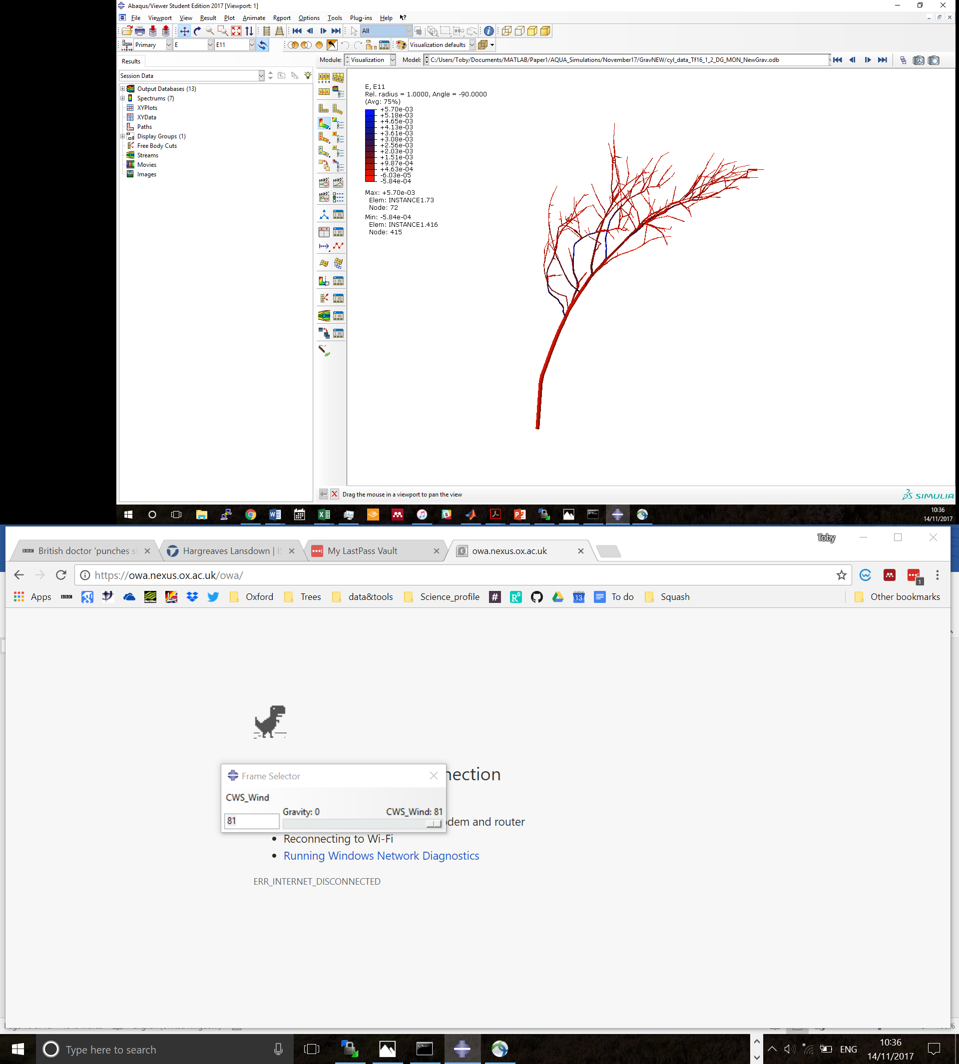
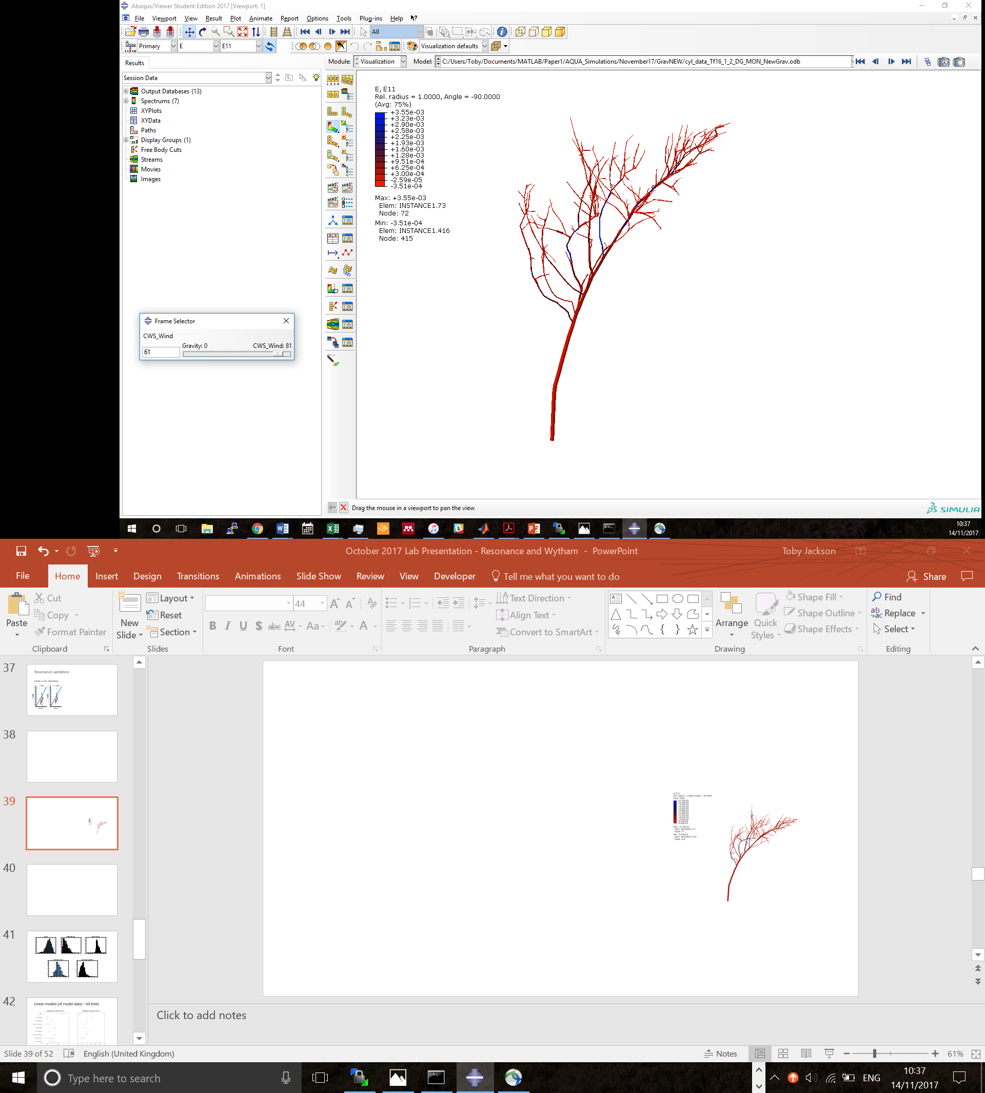
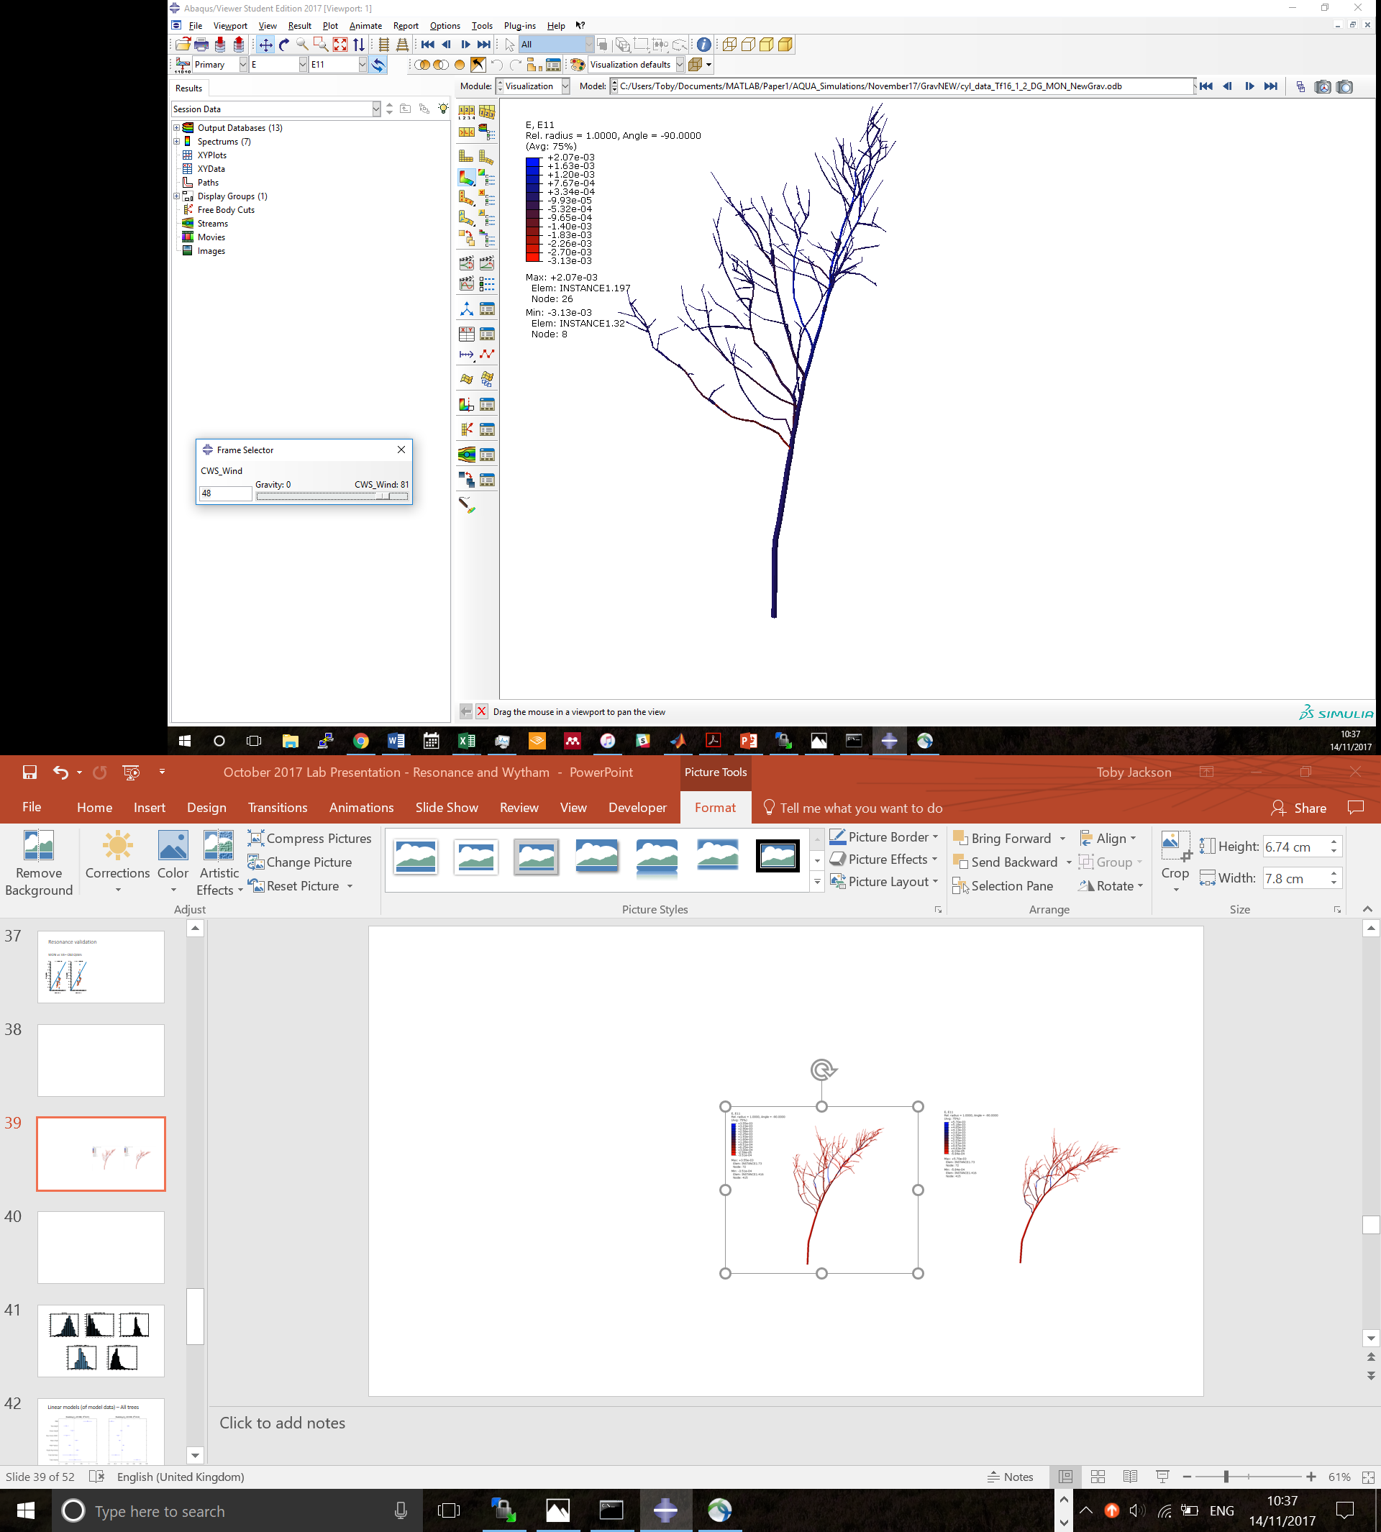
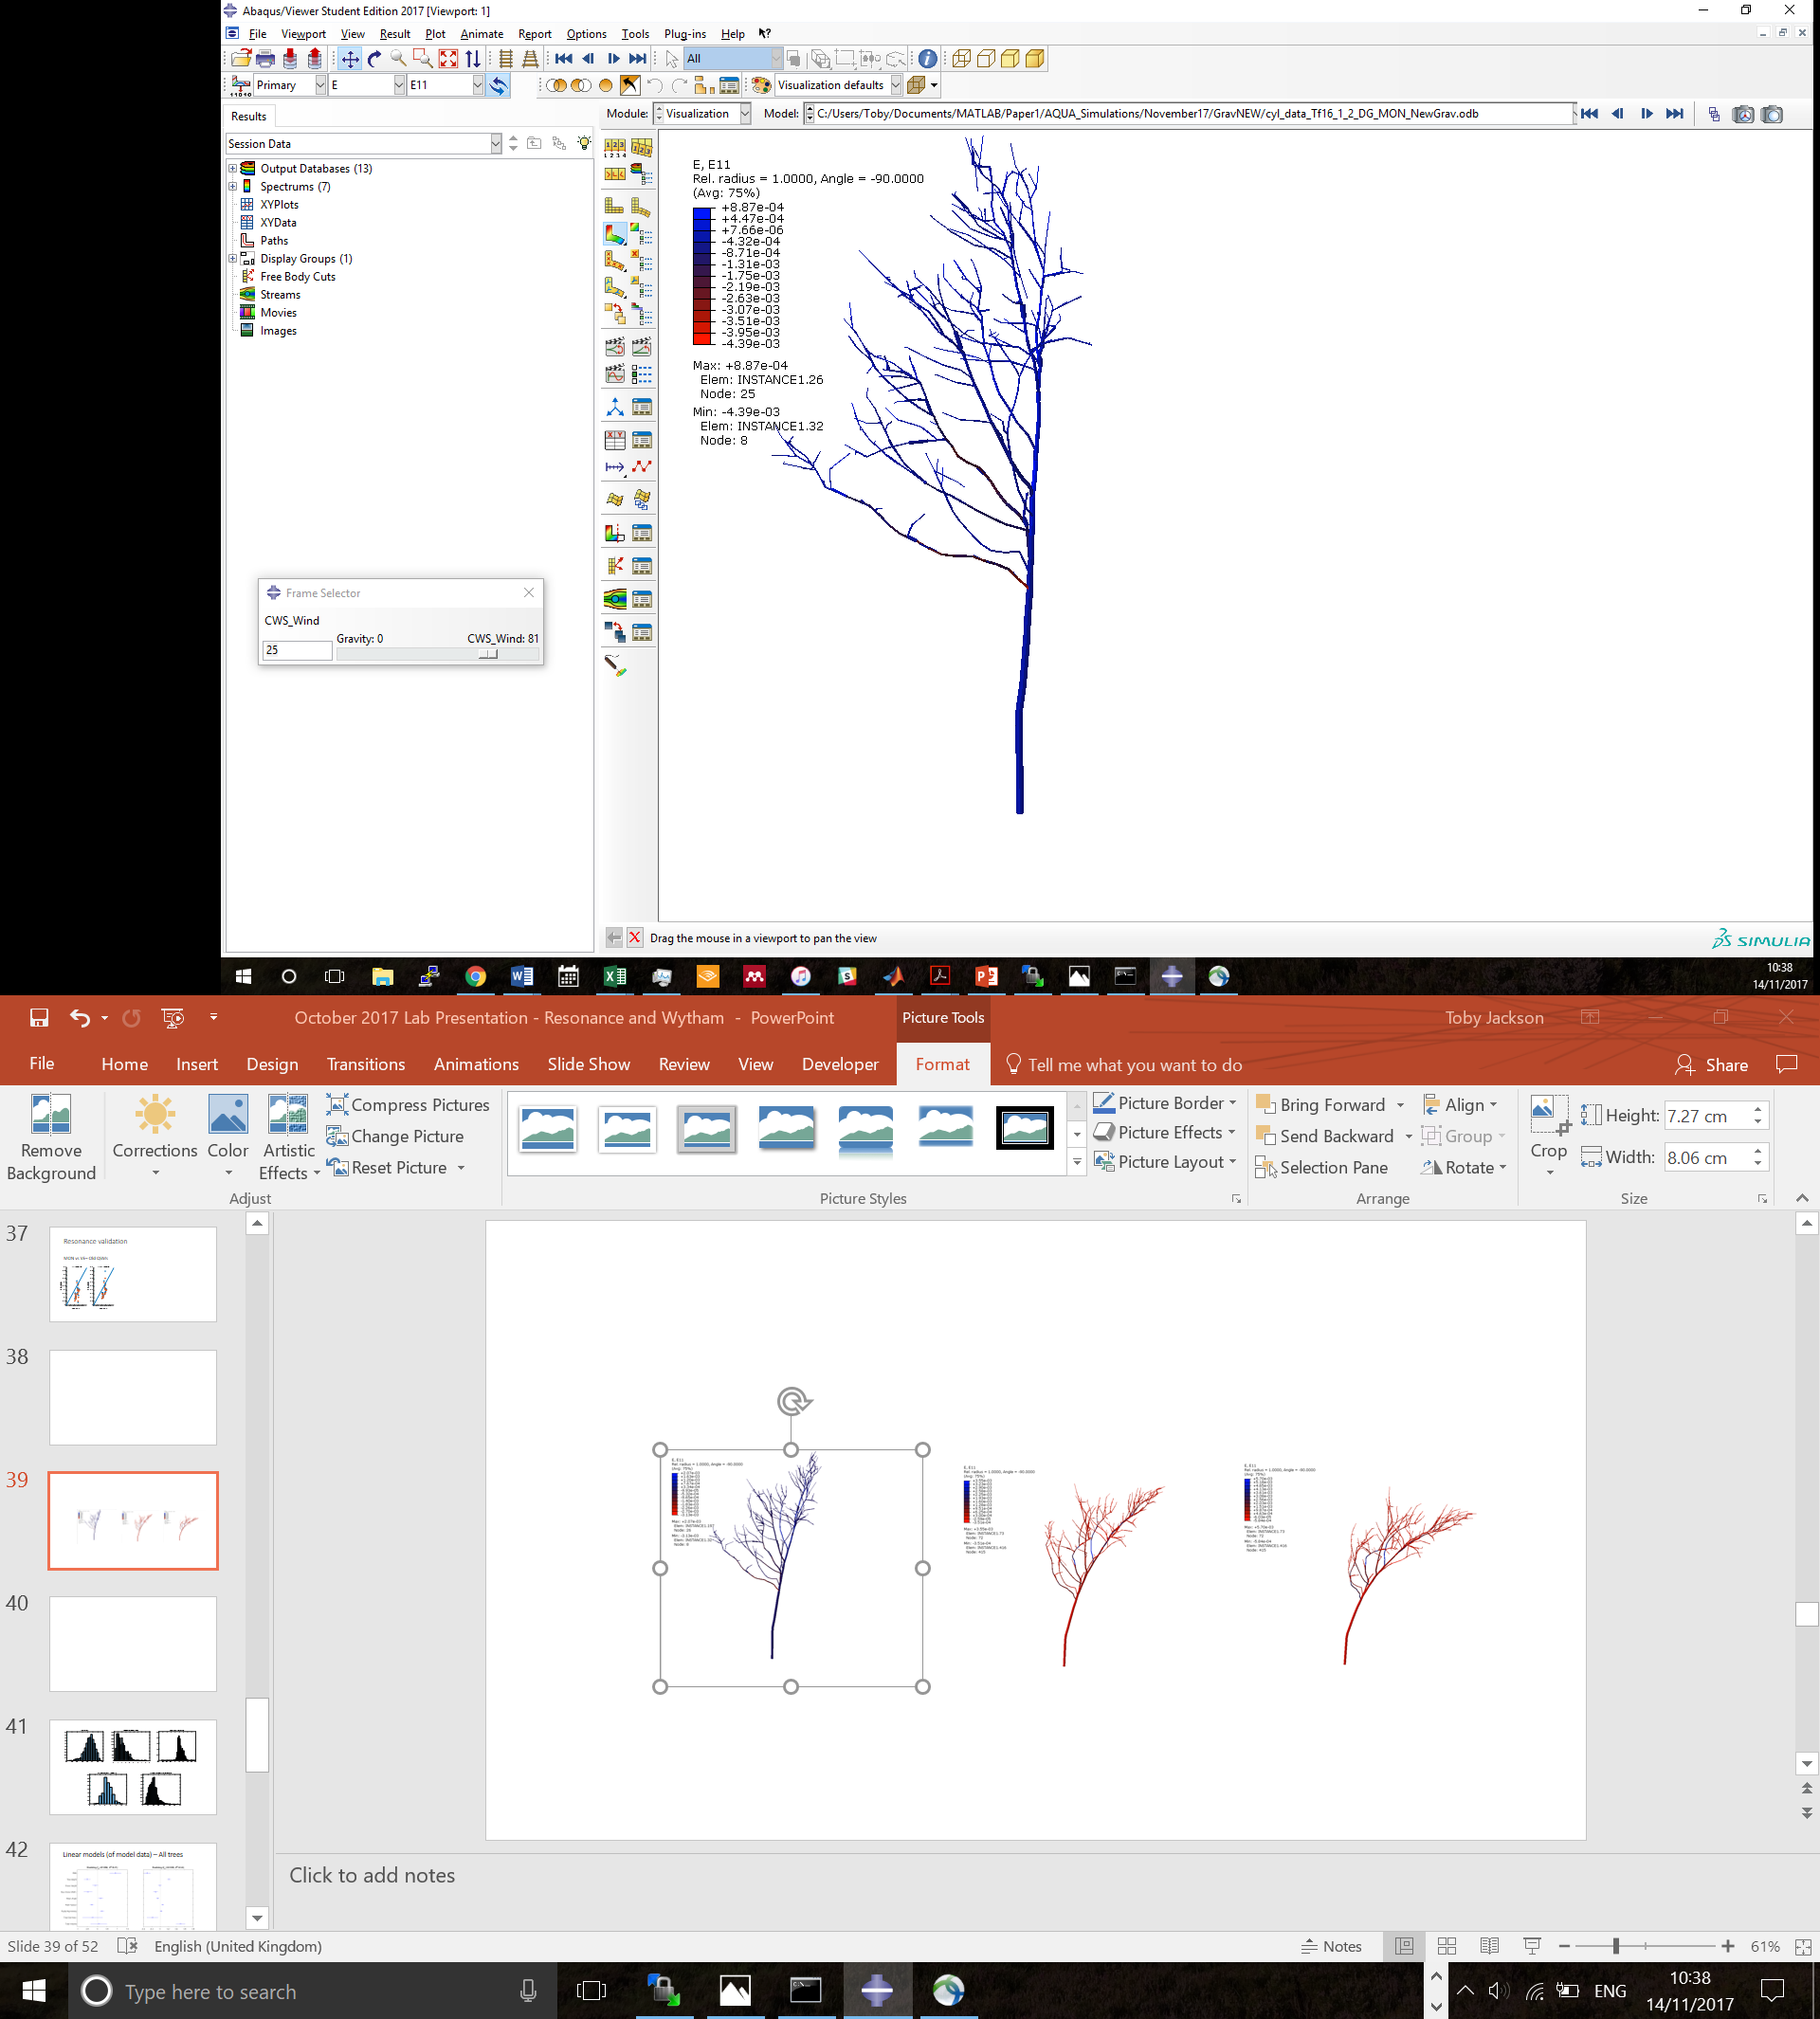
Model CWS
Each tree is modelled individually

Slide 23
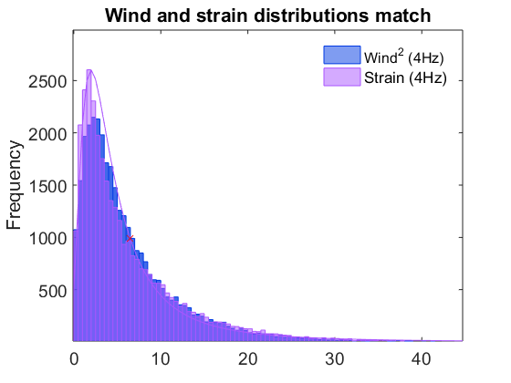
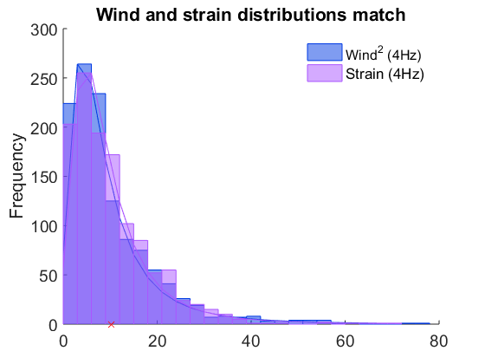
Dynamical Amplification Factor?

